Slide 1


KNOW-IT(PG-DAC SEPT 2021) PROJECT TITLE E-SHOPPING.COM
PROJECT MEMBERS
1.Paresh Jadhav-210943020029
2. Rajeshri Bhandekar-210943020012
3.Kalyani Gajare-210943020022
4.Akshay Varade-210943020107

Slide 2
CONTENTS
1.Project Introduction
2.Project Architecture
3.Technologies used
4.Database Introduction
5.User Roles and Responsibilities
6.Future Extension
7..Conclusion

Slide 3
INTRODUCTION OF THE PROJECT
The main objective of this project is building an application which will help selling of electronics goods on large scale.
This web application helps to reduce the delivery price of the product and also delivery time will be reduced.
This webapp will help customers to get all electronics products at their doorstep.

Slide 4

PROJECT ARCHITECTURE
Used for
User Interfacing
Basic data Validation
Used for
Server side validations, if needed
Response Handling
Business Logic
Database Operations
Used for
Permanent Data Storage
Database level validations
Database access using stored procedures
Front End Layer
Server Layer
Database Layer

Slide 5






TECHNOLOGIES USED
1.Java
2.Spring Boot REST API
3.JPA
4.React Js
5.Bootstrap
3.MySQL

Slide 6
REASON FOR SELECTING SPECIFIC TECHNOLOGIES
React Js as a frond-end technology-
It helps to build rich user interfaces
It allows writing custom components
It offer better code stability
UI-focused designs
Reusable Components
Spring Boot as a back-end -
Simplified & version conflict free dependency management through the starter POMs.
We can quickly setup and run standalone, web applications and micro services at very less time.
No XML based configurations at all. Very much simplified properties. The beans are initialized, configured and wired automatically.
You can create a skeleton project with web, data access (relational and NoSQL datastores), cloud, or messaging support.

Slide 7
INTRODUCTION TO DATABASE
Table names with attributes-
1.Login – login_id, username, password, type
2.Customer – cust_id, cust_name, email, contact, address, city, login_id(fk)
3.Shipper – ship_id, shipper_name, city, contact, login_id(fk)
4.Order – oid, amount, status, orderdate,deliverydate, cust_id(fk), ship_id(fk)
5.Order Items – oi_id, prod_id(fk), oid(fk)
6.Products – prod_id, cat_id(fk), prod_name, prod_desc, price, qty
7.Category – cat_id, category_name
8.Bill – bill_id, oi_id(fk), amount, invoice_time

Slide 8

USERS AND THEIR FUNCTIONALITY
Customer User–
Customer is the user of system who wants to buy the product.
He is also able to view the other products available, prices and description of products,.
He can buy product.
He can see order summary of his orders.

Slide 9

Admin User-
Login
Logout
Shipper Register
Customer Register
Add product

Slide 10

Shipper User-
Login
Logout
Change Delivery status
View order and customer details

Slide 11

FUTURE SCOPE
1.Message Acknowledgement Module
In following conditions acknowledgement to be send
1.After successful registration.
2.After successful Order/Purchase.
3.After successful Cancellation of Order
4.After successful Returning the Product.
2. Cancel order
3.Return Product
4.Refund amount

Slide 12
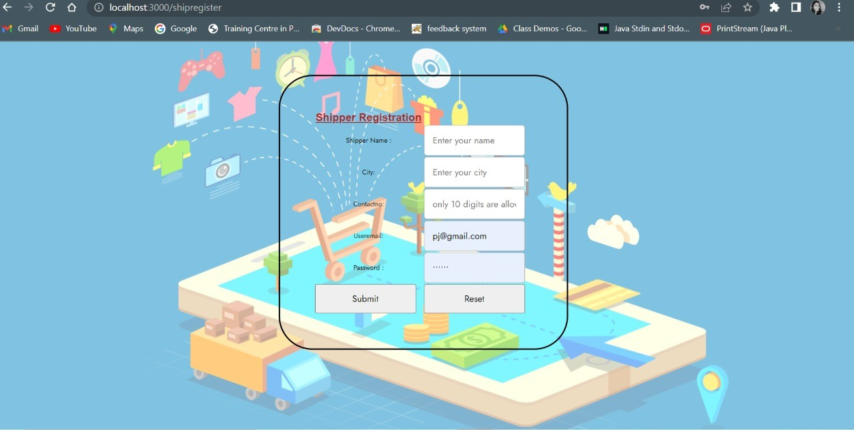
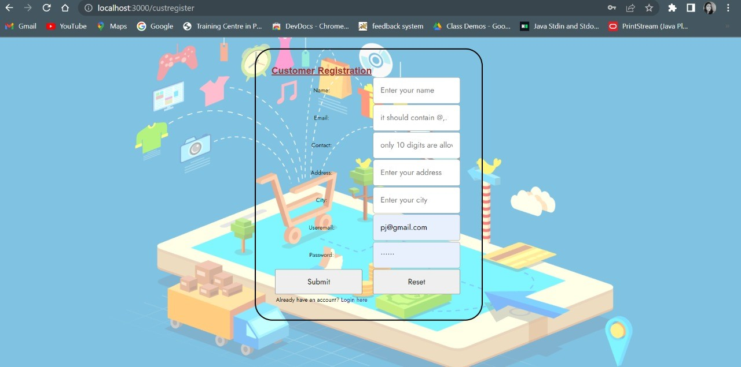
IMAGES OF WEBPAGE
Shipper Registration Page
Customer Registartion Page

Slide 13
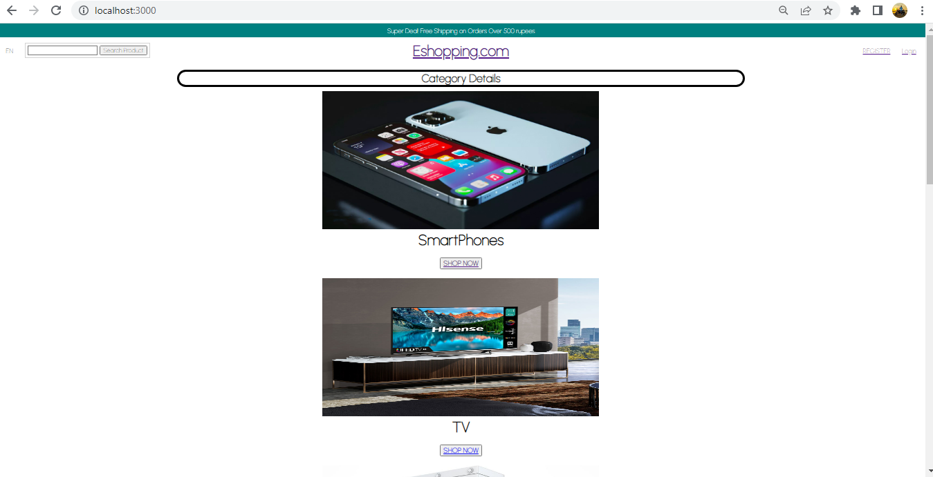
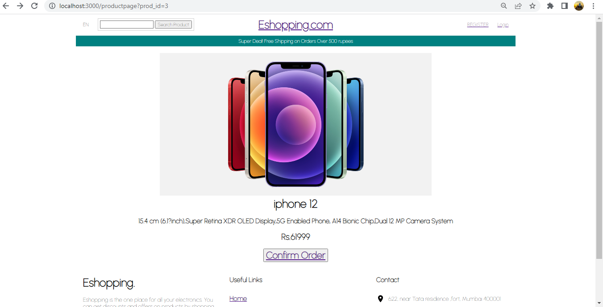
IMAGES OF WEBPAGE
Home Page
Order Page

Slide 14
CONCLUSION
The basic functionality like login and registration of all the users is done.
Also the customer dashboard has been created to see all the products and buy them.
Shipper dashboard is designed with basic info display required for shipper role.
Many things like message acknowledgement, payment gateway and add to cart functionality are still in future scope of the project.
We have learned many concepts related with technologies used during project phase.
Also have gained confidence of coding and presenting.
THANK YOU!!

Slide 15
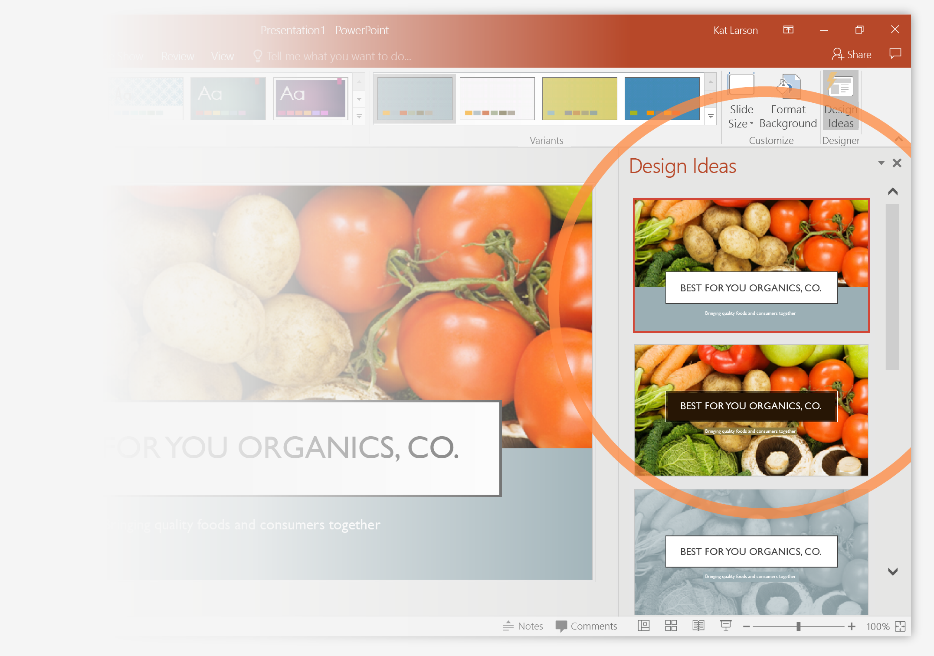
Designer helps you get your point across
PowerPoint Designer suggests professional designs for your presentation, based on the content in your slides.
Designer is a subscription-only feature. If you have an Office 365 subscription, the next slide shows you how it works in a new presentation.

Slide 16
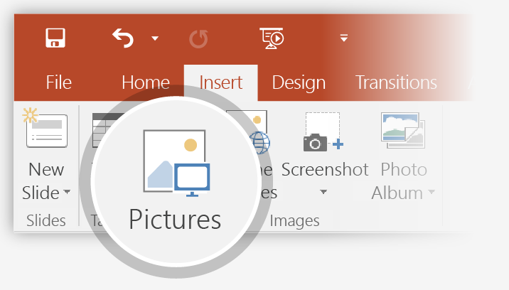
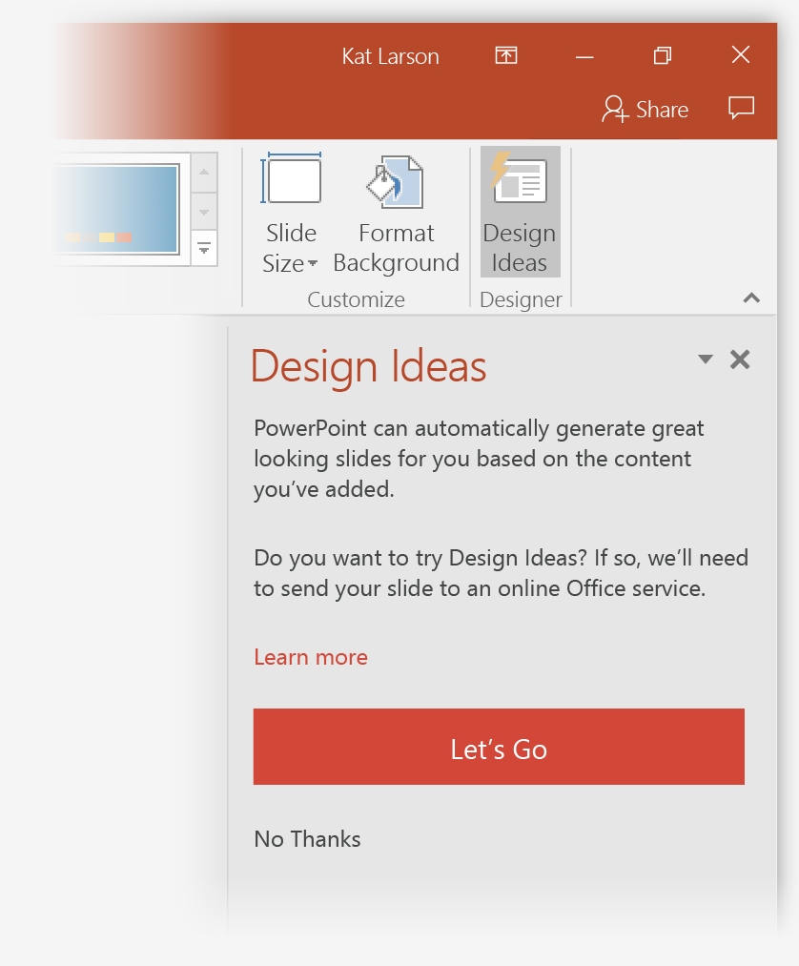
How to use PowerPoint Designer
How it works:
1
Start a new presentation by going to File > New > Blank Presentation.
2
On the very first slide, add a picture: Go to Insert > Pictures or Insert > Online Pictures and choose the picture. Hint: You need to be online when you add the picture.
3
When PowerPoint asks your permission to get design ideas, select Let's Go.
4
Choose a design you like from the Design Ideas task pane.

Slide 17
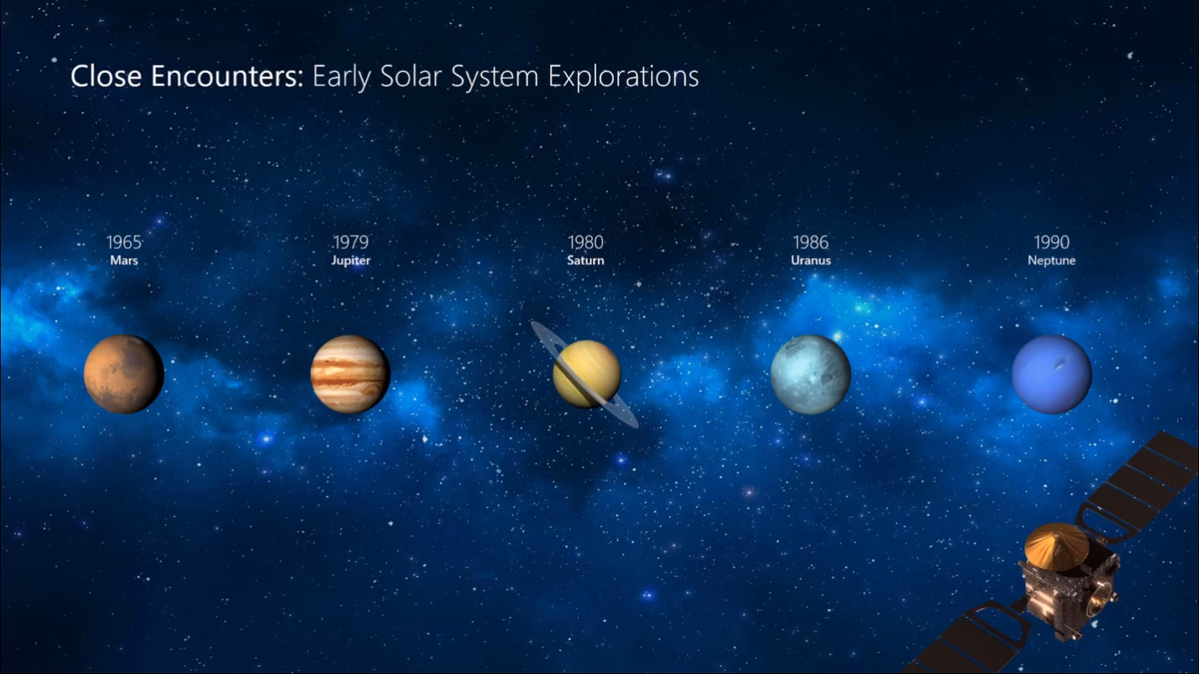
Morph
Morph makes smooth animations and object movements in your presentation. You use two similar slides to perform the animation, but it looks to your audience like the action happens on one slide.
Play the video on the right to see a quick example.
Morph is a subscription-only feature. If you have an Office 365 subscription, you can try it yourself with the steps on the next slide.

Slide 18
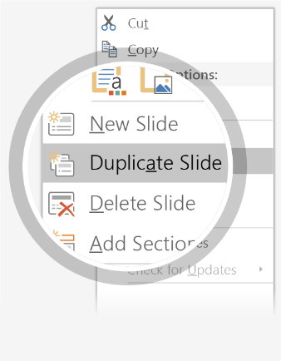
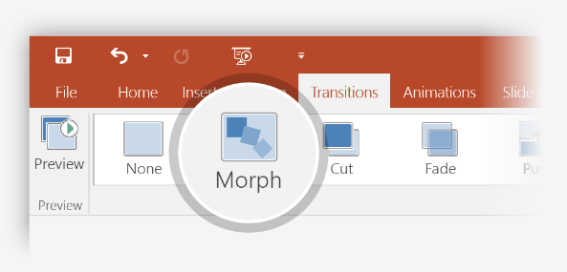
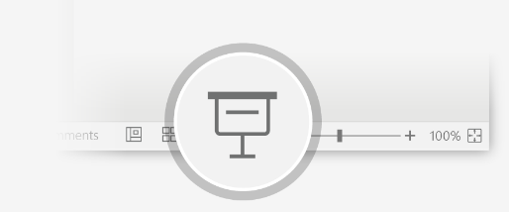
Setting up Morph
Try it yourself with these two simple “planets”:
1
Duplicate this slide: Right-click the slide thumbnail and select Duplicate Slide.
2
In the second of these two identical slides, change the shapes on the right in some way (move, resize, change color), then go to Transitions > Morph.
3
Return to the first of the two slides and press Slide Show button and then select Play to see your circle morph!
Hint: Effect Options gives you even more options for Morph.

Slide 19
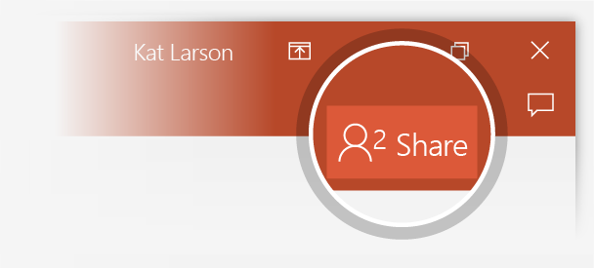
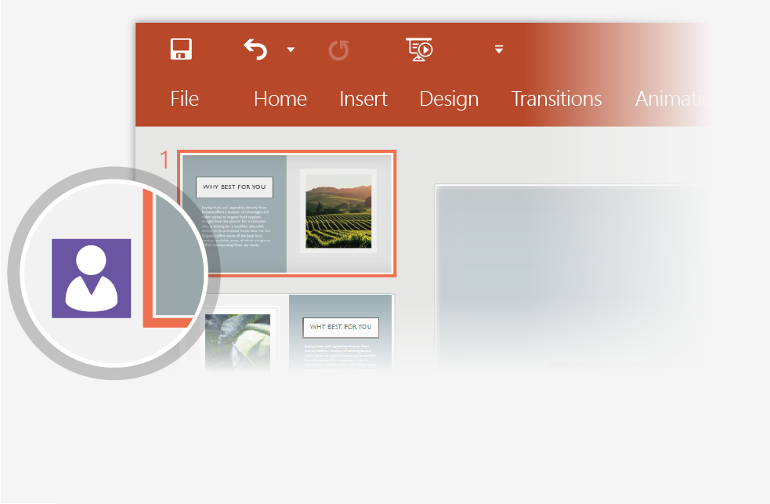
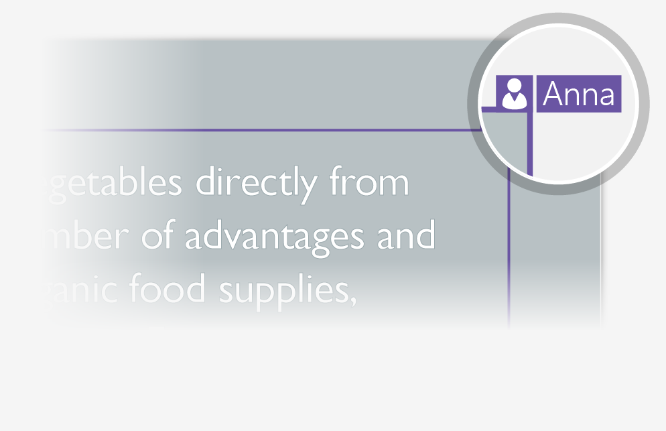
Working together in real time
When you share your presentation with others, you’ll see them working with you at the same time. How it works:
1
Select Share from above the ribbon, or by using short-key Alt-ZS, to invite people to work with you (You can save to the cloud at this point.)
2
When other people are in the presentation, a marker shows who is on which slide…
3
…and the part of the slide they're editing.

Slide 20


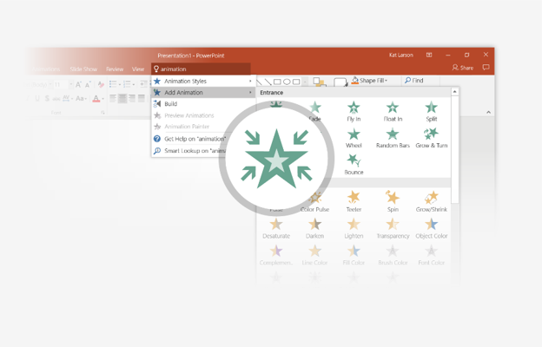
You’re an expert with Tell Me
The Tell Me box finds the right command when you need it, so you can save time and focus on your work. Try it:
SELECT ME
1
Select the Robot picture on the right.
2
Type animation in the Tell Me box, and then choose Add Animation.
3
Choose an animation effect, like Zoom, and watch what happens.

Slide 21
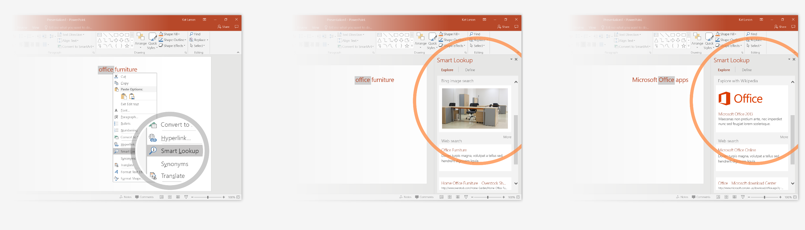
Explore without leaving your slides
Smart Lookup brings research directly in to PowerPoint. Try it:
1
Right-click in the word office in the following phrase: office furniture
2
Choose Smart Lookup, and notice that results are contextual for that phrase, not Microsoft Office apps.
3
Just for fun, try Smart Lookup again by right-clicking in the word Office in Step 2.

Slide 22

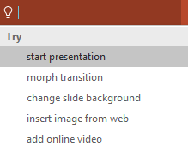

More questions about PowerPoint?
Select the Tell Me button and type what you want to know.
Visit the PowerPoint team blog
Go to free PowerPoint training
SELECT THE ARROW WHEN IN SLIDE SHOW MODE

